Slide 1
Using an Artificial Neural Bypass to restore Cortical Movements in a Human with Quadriplegia
Ben Chernoff
Natalia Galant

Slide 2
Background
How do humans control limb movement in an efficient way that takes into account external cues and changing environment?
Important for: recovery from trauma, ability to walk, quality of life
Environment
Brain
Spine
Muscles
Limbs

Slide 3
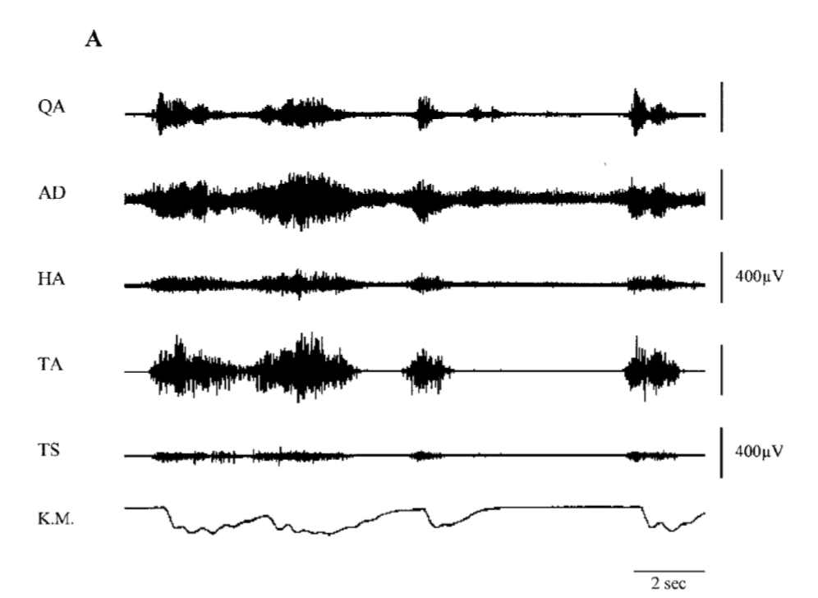
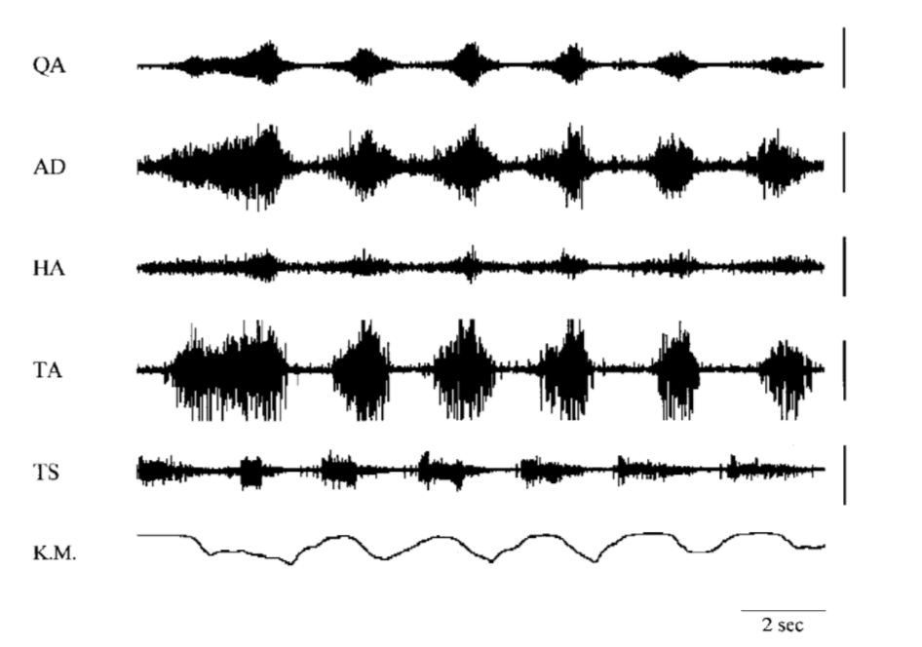
Dimitrijevic (2007)
Electrical stimulation of the thoracic and lumbar spine in paraplegic patients
Can stimulation of the spine induce rhythmic motor movements in the limbs, in the absence of signal from the brain?

Slide 4
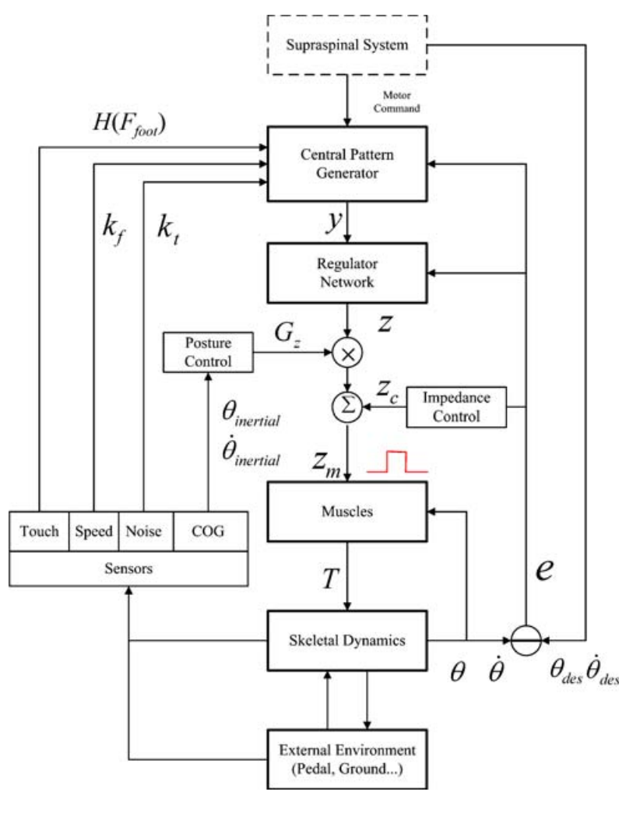
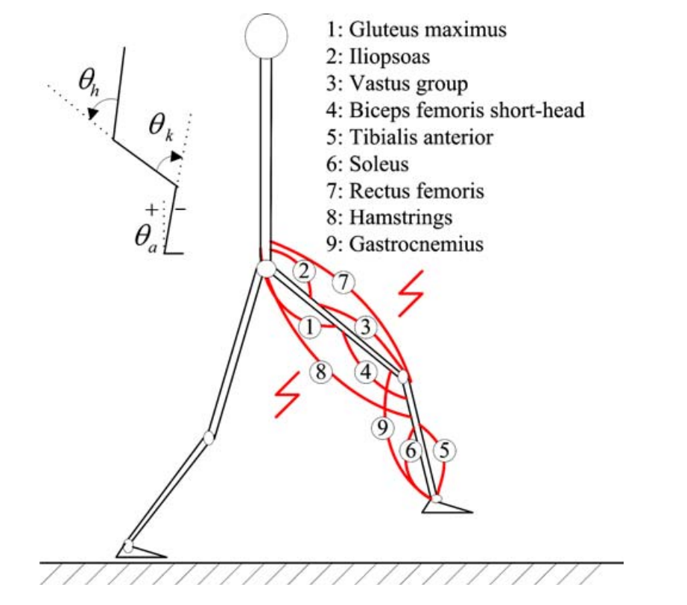
Zhang (2007)
Can we build an FES model to predict movement for walking?
Notes:
The Central pattern generator (CPG) generates the rough rhythmic walking patterns that will be finely regulated by the regulator network. Postural control is in charge of body balance control during walking. Impedance control is to provide rough regulation and resist disturbance. The final control signal z_{m} is the result of the combined actions of these controllers. Several types of sensors are fed back for the controllers. The musculoskeletal model is the object controlled

Slide 5
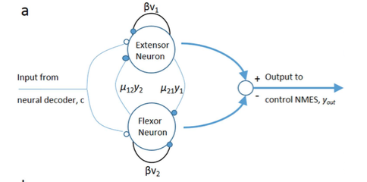
Matsuoka (1985)
Notes:
Sustained oscillations – Natalia will go into more detail on how this works

Slide 6
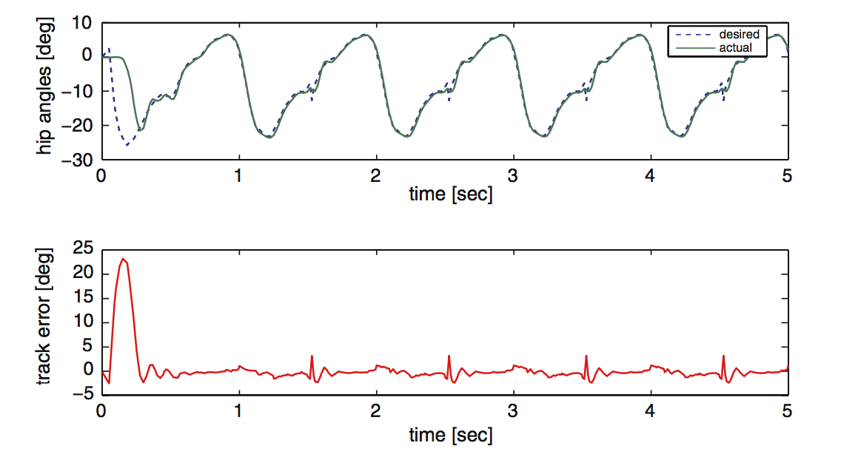
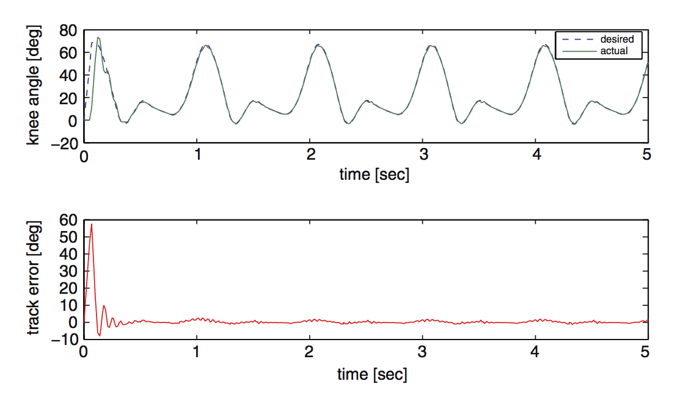
Zhang (2007)
Hip performs well
Knee performs very well

Slide 7
Sharma (2016)
Single patient with tetraplegia
96 channel multi-electrode array implanted in motor cortex
Can SVM be used as a way to “bypass” the CPG mechanism in the spine?

Slide 8
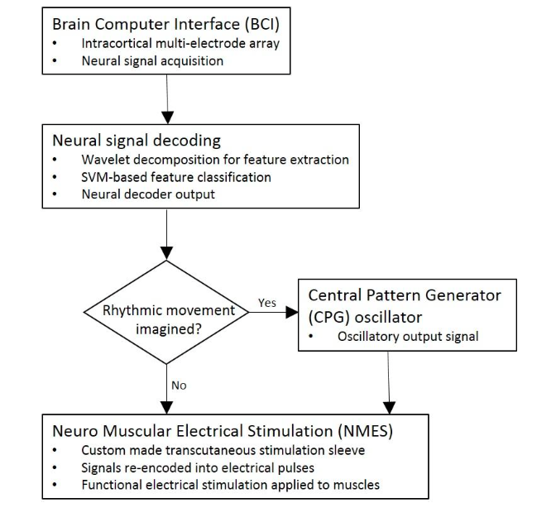
Notes:
Diagram summary: The idea is that they can obtain signals from the participant’s brain , outsourcing them through all this processing to bypass the injury
And produce voluntary motor output
obtaining signals from the participant’s brain: Their motor cortex is in tact so those signals should be unaffected so in theory these signals
These signals then (in theory) can be used to electrically stimulate the muscles restoring the rhythmic movements or discrete movements.
Reason for svm: Signals initiating these two types movements are distinguishable and require different processing
so a classifier must be incorporated in order to determine which movement is being initiated based on the signal.
Numeric CPG model comes into play – used only for rhythmic movements

Slide 9
Notes:
So before I go into their whole set up of their CPG model I’m just going to briefly walk through how they interfaced everything

Slide 10
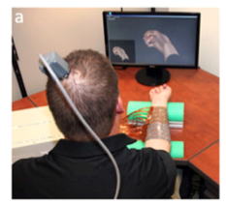
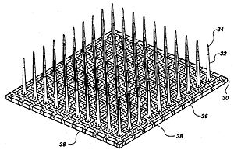
Notes:
So in order to get these neural signals…
implanted this multi-electrode array into this guys motor cortex
Which is the area of the brain responsible for controlling voluntary movements
This gave them the ability to record the electrical activity of the neurons in this area of the brain

Slide 11
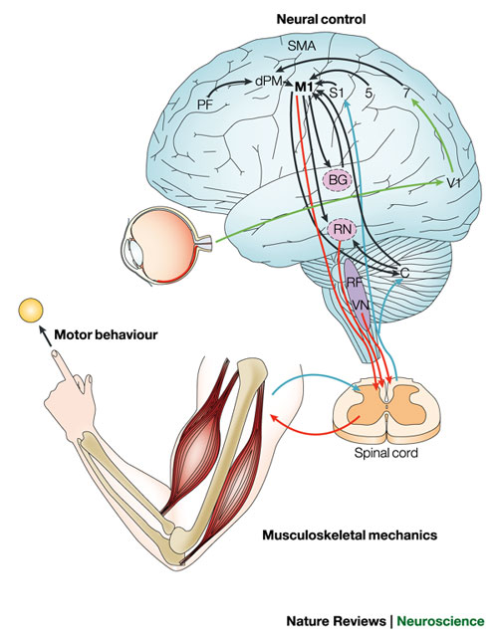
Electrode Array
Central
Pattern Generator
Bypass
Neuromuscular Stimulation Sleeve
Notes:
- They are trying to recreate the path in red here
The electrodes are implanted in M1 (motor cortex) – the signals are preprocessed and sent to the CPG
So to bypass this, the electrical activity in M1 is recorded and after some pre-processing of these signals is sent to the numerical model of the cpg
And upon receiving this input the cpg then outputs a signal which is then sent to stimulation sleeve wrapped around the participants wrist and directly stimulates these muscles

Slide 12
Notes:
After acquiring these neural signals
So what they need to do next is determine what type of movement the participant was trying to accomplish – 3 options
- flex
- extend
If the participant is trying to accomplish some sort of discrete movement (so flexing or extending his thumb/wrist) → signal sent directly to stimulation sleeve
If the desired movement is some sort of oscillatory patter, then that’s where their CPG comes into play

Slide 13
What type of movement?
Discrete ➔ NMES Sleeve
  Flexion
  Extension
Oscillatory ➔ CPG MODEL ➔ NMES Sleeve
Notes:
Discrete: signal sent directly to the stimulation sleeve
Oscillatory: CPG model comes into play before a signal is sent to the stimulation sleeve

Slide 14
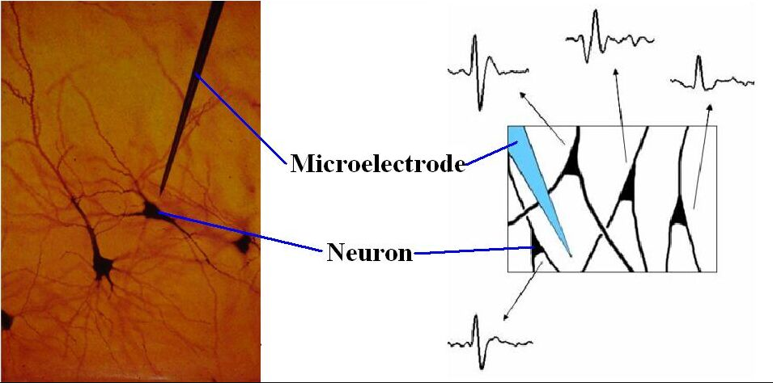
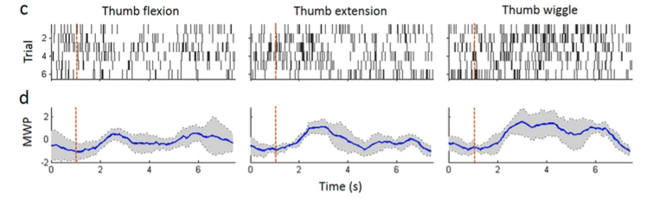
Pre-processing: Wavelet Transform
Notes:
So once they acquire these neural signals they do a Wavelet transform on the data: this just means that they transformed the recordings into a frequency-time distribution
So this is what it looks like zoomed in – so there’s this 96-electrode array in this guys brain and what a single electrode does is it measures the rate of change of voltage with respect to time
So that means that they’re able to measure these discrete electrical impulses as they’re recording – because they’re discrete we need to do some sort of transformation to get the signal to look like a wave
Wavelet power– i.e. action potentials per second (the frequency at which the neuron is firing)
Mean wavelet power: average over 6 trials
So this blue signal is what is fed into the model for further processing

Slide 15
Notes:
So these signals (taken from each electrode) are fed into their model where the next step is determining the type of movement

Slide 16
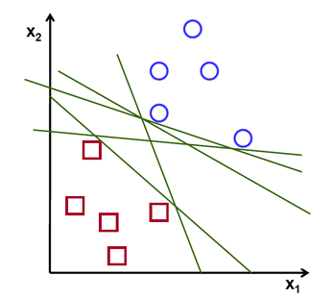
SVM: support vector machine
Notes:
The type of classifier they used for this step….A hyper-plane is drawn through the n-dimensional feature space such that these classes are separable
We can see the that when plotted these different classes are separable

Slide 17
Training the Decoder
Participant is asked to imagine mimicking one of the 3 movements
Recordings from the electrode array are wavelet-transformed and fed into a SVM classifier
SVM classifies the desired movement as thumb flexion, extension, or rhythmic
96 features (MWP for each multi-unit recording in the array)
  Values updated every 100ms
Notes:
1) Used to train the classifier – input is the pre-processed signal and the label is the movement they are asked to mimic

Slide 18
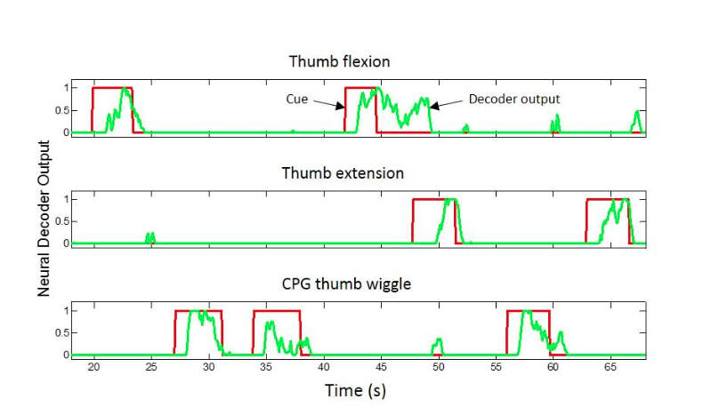
Neural Decoder Output
Notes:
And here’s what the decoder looks like in real time and you can see that although there is some error, the output closely resembles the cue a lot of the time
Error: cue says rest and the decoder is producing some output anyway -

Slide 19

Notes:
Show video
And eventually when they tested it…the participant was able to think about a signal

Slide 21
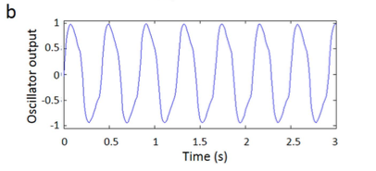
CPG Oscillator
Goal: Numeric model of a CPG capable of generating rhythmic/oscillatory outputs (like the biological CPGs in the spinal cord)
Notes:
The goal of this oscillatory was to get the output signal to look like the one that would be coming from the spinal cord
Trying to get the output of this to look like this – stable periodic oscillations

Slide 22
CPG Oscillator
Based on a two-neuron oscillator model
Two neurons in a mutually inhibitive network
Notes:
Based on a two-neuron oscillator model – this is a model of the biological network in the spinal cord – been around for a long time (1996)
The term they use to describe this network is ‘mutually inhibitive’
Flexor neuron is ‘stimulated’ – its producing action potentials at some frequency
-as it fires, its signal is propagated forward but also it sends an ‘inhibitory signal’ to this extensor neuron neuron reducing it’s output
but it also inhibits itself and as it does that its output is reduced, reducing this inhibition on the other neuron
This offset of inhibition results in the periodic / oscillatory output
Parameters: at these connections Mu is the weight of these connections and Beta you think of as the weight of a neuron connected to itself

Slide 23
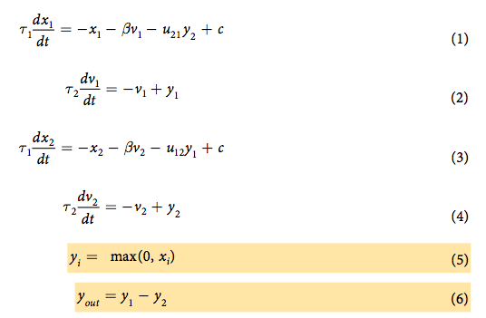
CPG Oscillator: optimization
Notes:
So for this network to output a periodic wave at a certain frequency
- parameters have to take on very specific values (otherwise the frequency would different or output wouldn’t look periodic at all)
- Set of parameters that can generate oscillatory behavior for a desired frequency are unknown
These parameters are unknown – becomes a constrained optimization problem in order to get these parameters – then used these parameters to solve this set of differential equations to generate CPG oscillator output

Slide 24
Paramters
c: output from decoder
ij: weight of interaction between neurons
: adaptive gain on self inhibition (weight of interaction between neuron and itself)
i: time constraints for adaption
Notes:
Parameters – going to quickly go through what these parameters are before I explain how they solved for them
c: output from decoder
t1,t2: time constraints on self inhibition (allows for an offset of inhibitory cascade – allows for inhibitory signal to reach other neuron before it inhibits itself)
m1,m2: weights of connections between the two neurons
B: adaptive gain on self inhibition -- weight of connection between a neuron and itself
Because of software and hardware limitations they couldn’t actually see if the participant could control the frequency of oscillation – rather they classified a movement attempt as ‘oscillatory’ and had the stimulation sleeve stimulate the muscles such that the limb moved back and forth at 2.5 Hz
Xi is the membrane potential: resting potential , Vis membrane current

Slide 25
Genetic Algorithm
Global optimization approach used
Parameters are adjusted in a manner that mimics evolution (multiple points generated at each iteration and the best point approaches the optimal solution)
Parameters adjusted at random rather than from a sequential/deterministic way
MATLAB
Notes:
They used this global optimization algorithm to solve for these parameters -- used matlab’s implementation
What this means is that parameters are adjusted in a manner that mimics evolution : multiple points are generated at each iteration and the best point approaches the optimal solution
Parameters are adjusted at random rather than in a systematic way

Slide 26
Output
Notes:
Once these parameters are solved for at different frequencies output from the decoder can be used as input, driving the CPG to produce stable oscillations

Slide 27
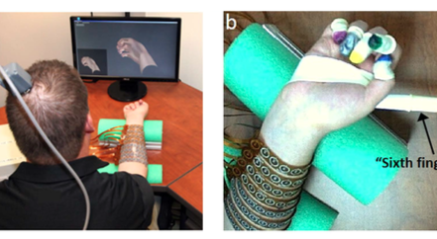
Output
Notes:
So that’s how they bypassed the processing that happens in the spinal cord
The output of this model is then sent to stimulate the muscles in order to initiate movement
(figure) wrapped around wrist – hydrogel disks allowing for electrical stimulation through the skin (nothing implanted surgically on this end)
Other:
Trial and error determined the appropriate spatial electrode pattern
(130 electrodes and hydrogel disks (12mm) in diameter)

Slide 28
Imagined Rhythmic vs. Discrete Movement
To test whether the pattern of neural activity was unique for rhythmic vs. discrete (extension, flexion) movements, the subject was cued with videos of each movement type
The subject imagined that movement and MWP was extracted from the neural data during movements

Slide 29
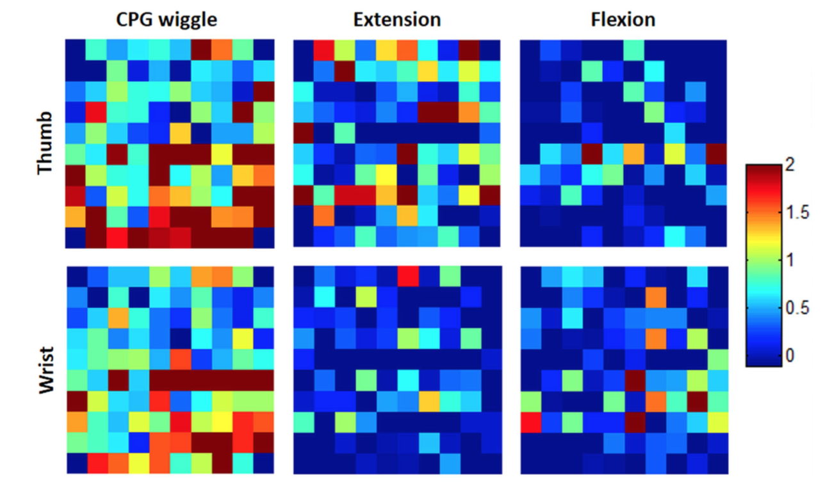
MWP Heat Map - Imagined vs. Discrete

Slide 30
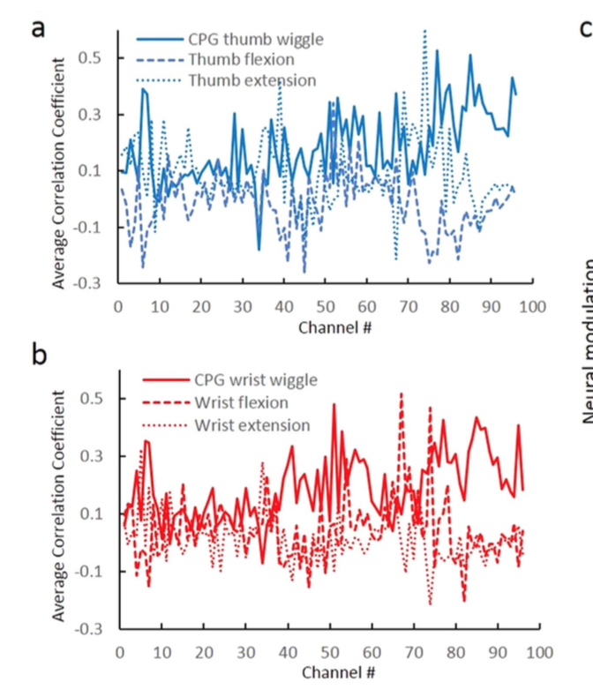
Correlation Between Cue and MWP
Correlations between cue and MWP for each movement types are significantly different on most channels, for both thumb and wrist
Notes:
The correlation was significantly different (p < 0.05) on 65 out of 96 channels when the participant imagined the rhythmic thumb wiggle compared to when he imagined thumb flexion and on 67 out of 96 channels for imagined rhythmic thumb wiggle compared to imagined thumb extension (Fig. 4a). Similarly, the correlation was significantly different (p < 0.05) for imagined wrist wiggle on 67 out of 96 and 74 out of 96 channels com- pared to imagined wrist flexion and extension respectively (Fig. 4b)
IF THEY WERE THE SAME, WE WOULDN’T EXPECT TO SEE DIFFERENCES BETWEEN DOTTED/STRAIGHT LINES

Slide 31
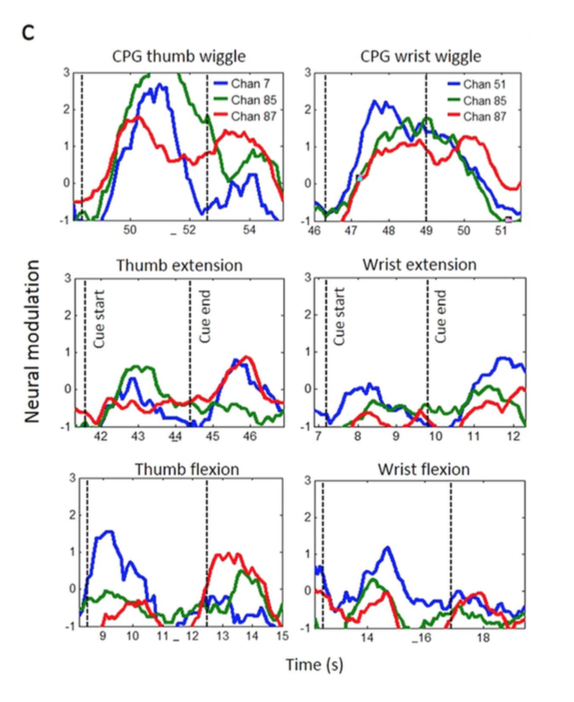
Representative Channels
Preferential modulation for CPG wiggle on three representative channels

Slide 32
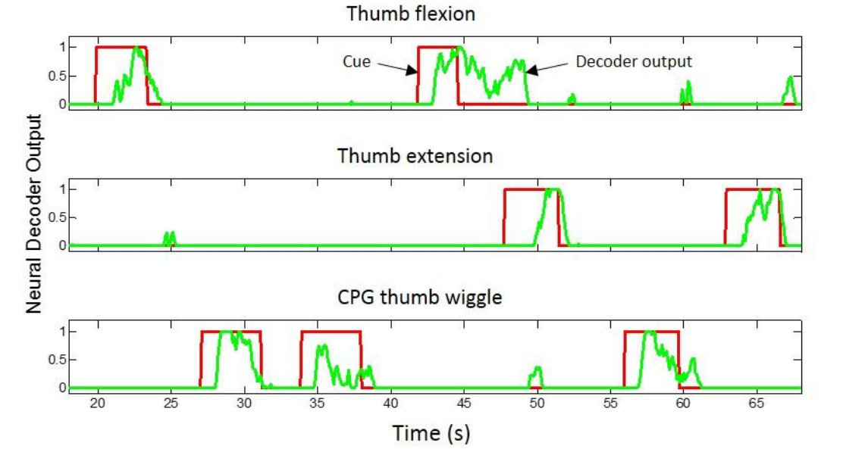
Neural Decoder
A neural decoder was used to predict the movement type

Slide 33
Evoked Movements from Neural Data
Can the neural decoder be used to evoke movements in real time?
The authors used thumb flexion, extension, and wiggle, to test if the decoder could be used to stimulate and produce accurate movements

Slide 34
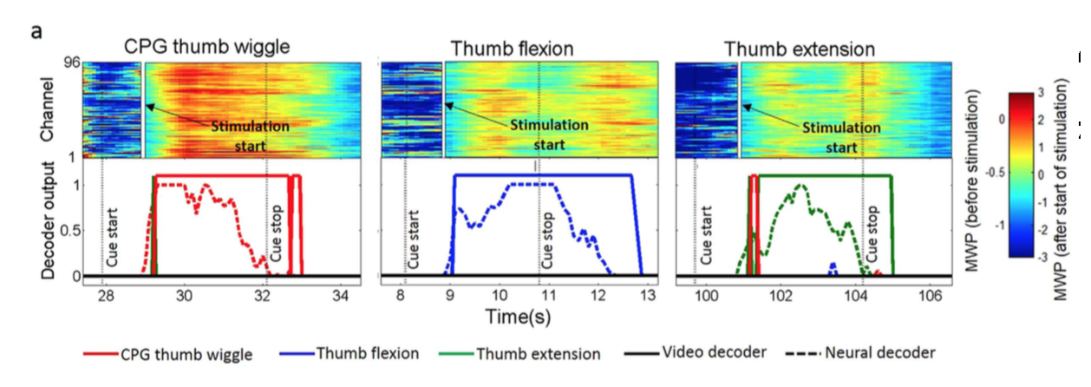
Evoked Movements from Neural Data
The neural decoder approximately follows the timecourse (with a lag) of the video decoder

Slide 35
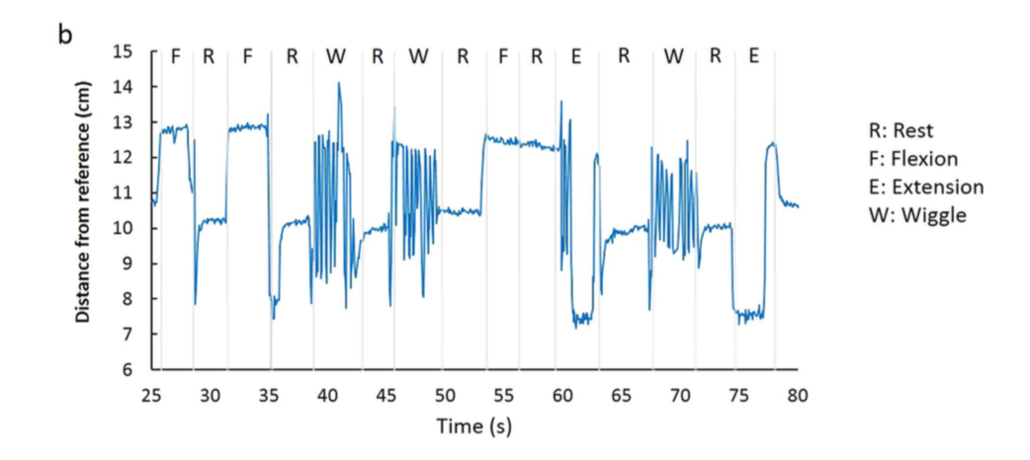
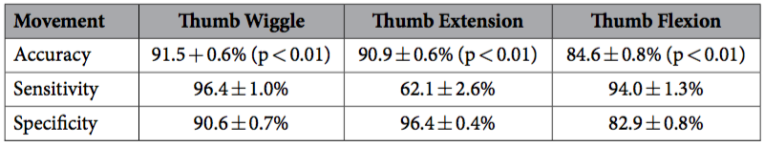
Evoked Movements from Neural Data

Slide 37
Concluding remarks
Notes:
Ben mentioned what has been done in field prior to this and this part of the model was the new-revolutionary thing this study was able to accomplish
This is the first time they were able to generate these rhythmic movements voluntarily

Slide 38
Implications?
Limitations?

Slide 39
Why is this important
Immediate implications:
  Gait training and hand-movement recovery
  Rhythmic motion provokes neural plasticity throughout the rehabilitation process
Rhythmic Behaviors:
  - locomotion
    Walking
    Running
Notes:
If we aren’t able to generate these rhythmic movements then restoring the ability to walk would be totally out of the question
Walking is a rhythmic behavior
Also, its been proven that after some brain injury (Post TBI, stroke, and spinal cord lesions) recovery is sped up by executing these rhythmic movements
Hope for restoration and rehabilitation to the paralysis population

Slide 40
Limitations
Invasive
Lack of sensory feedback
Couldn’t independently control amplitude and frequency
  Although this adjustment is “easy” due to the biologically-based model
Only tested at one frequency (2.5 hZ)
Notes:
Sensory feedback– (blue path) although not necessary for CPG, can make the system adaptive to sensory changes (important for walking)
Amplitude was set to the maximum range of motion of the participant
We know that it is possible to voluntarily initiate and terminate oscillatory movements but it is unclear if the actual frequency can be controlled voluntarily

Slide 41
Future Directions
Attempt voluntary control of amplitude of oscillations
Include sensory feedback
  More robust system

